Slide 1


Predicting Hospital Readmission Risk: Hackathon Pitch
Utilising Logistic Regression to reduce avoidable hospital readmissions and improve patient outcomes – addressing a critical healthcare challenge with high costs and significant patient impact.
Team(SC1)3_02
{NIKHIL KUMAR(23CSEAIML129),
ATUL KUMAR(23CSEAIML181),
Ambikesh Maharana(23CSEAIML173),
Abhinav Kumar(23CSEDS042)}
Notes:
1

Slide 2



The Problem: Hospital Readmissions
Approximately 20% of Medicare patients are readmitted within 30 days post-discharge, highlighting a significant issue in patient care continuity.
Unplanned readmissions cost the US healthcare system an estimated $15-20 billion annually, placing a substantial financial burden on resources.
Beyond costs, readmissions disrupt patient recovery, increase health risks, and strain already stretched hospital resources, affecting overall healthcare quality.
Notes:
2

Slide 3

Data and Key Features Used
Our model leverages a comprehensive dataset for robust prediction, including:
Patient demographics: Age, gender, and other personal attributes.
Medical history: Chronic conditions, past diagnoses, and treatment protocols.
Lab results: Key clinical markers and diagnostic test outcomes.
Prior admissions: Frequency and reasons for previous hospital stays.
Social determinants of health: Factors like socioeconomic status, education, and living conditions for a holistic view.
All data is sourced directly from Electronic Health Records (EHR) to ensure accuracy and completeness.
Notes:
3

Slide 4
Why Logistic Regression?
Handles Multiple Factors
Interpretable Model
Optimal Performance
Widely recognised and easy to understand for binary classification tasks in healthcare, providing clear insights into risk factors.
Efficiently incorporates various patient risk factors, with transparent coefficient insights indicating their impact on readmission probability.
Supports hyperparameter tuning (e.g., penalty and regularisation techniques) to achieve the best predictive performance for specific datasets.
Notes:
4

Slide 5
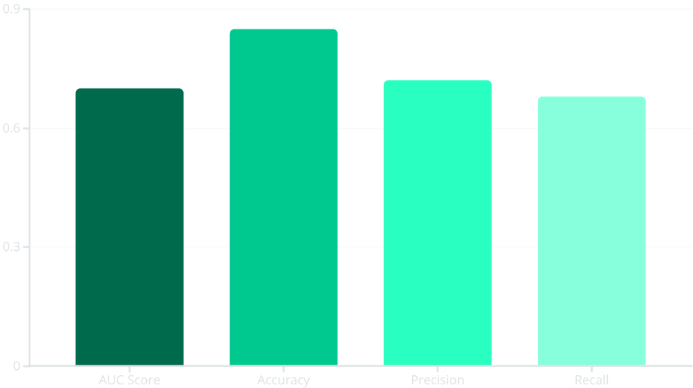
Model Performance & Validation
Our Logistic Regression model demonstrates competitive performance in predicting readmission risk, achieving an impressive Area Under the Curve (AUC) of approximately 0.70.
To ensure robustness, we employed rigorous cross-validation techniques and GridSearchCV for meticulous hyperparameter optimisation, fine-tuning the model for peak accuracy.
When benchmarked against other predictive models, Logistic Regression consistently strikes an optimal balance between predictive accuracy and essential interpretability, making it a reliable choice for clinical settings.
Notes:
5

Slide 6



Implementation & Use Case
Real-time Risk Scores
Targeted Interventions
Personalised Planning
Seamlessly integrated into existing hospital Electronic Medical Record (EMR) systems, providing instant readmission risk assessments.
Enables clinical teams to prioritise high-risk patients, facilitating timely and tailored interventions to prevent readmissions.
Supports the creation of individualised discharge plans and automated follow-up scheduling, enhancing continuity of care.
Notes:
6

Slide 7



Competitive Advantages
Transparent & Explainable
Efficient Data Utilisation
Scalable Solution
Our Logistic Regression model provides clear, interpretable insights, building trust among clinicians and facilitating data-driven decisions.
The model effectively uses routinely collected hospital data, minimising the need for additional data collection or complex integration processes.
Our solution is highly adaptable and can be seamlessly deployed across diverse hospital settings and varying patient populations.
Notes:
7

Slide 8

Conclusion & Next Steps
Our Logistic Regression model offers effective and reliable readmission risk prediction, capable of making a significant impact.
This solution has the potential to reduce readmission rates, improve overall care quality, and lower healthcare costs, creating a healthier future for patients and providers.
Next Steps:
Pilot Deployment: Implement the model in a clinical setting for real-world testing.
Clinician Feedback: Gather insights for iterative model improvements.
Model Refinement: Continuously enhance accuracy and utility based on feedback and data.
Notes:
8

